Slide 2
WHY AUDIT ASSISTANT?
Certifications require different amounts of CPE at different times.
Auditor Assistant eases tracking CPEs.
CIA
Reporting cycle begins two years after being certified.
40 hours of education must be completed.
CFE
Reporting cycle begins after next membership renewal month.
20 hours of education must be completed.
CISSP
Reporting cycle begins at the anniversary of being certified.
40 hours of education must be completed.

Slide 3
HOW?
JAVA
MYSQL
PRIMEFACES

Slide 4
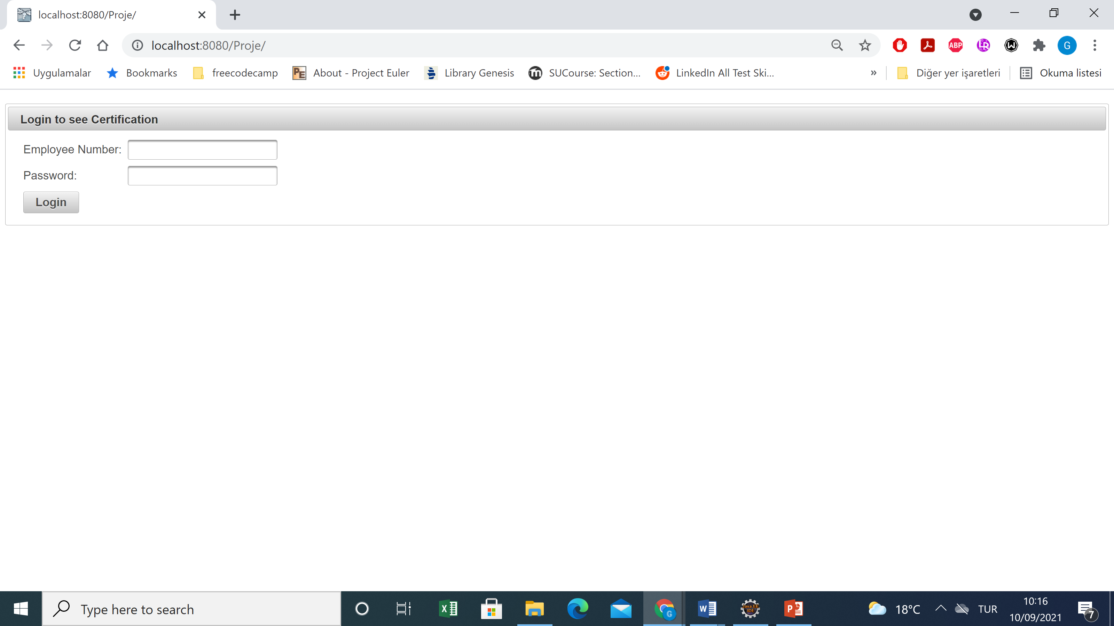

Slide 5
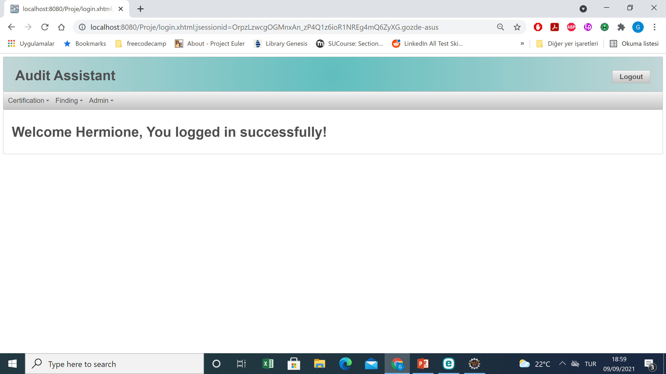

Slide 6
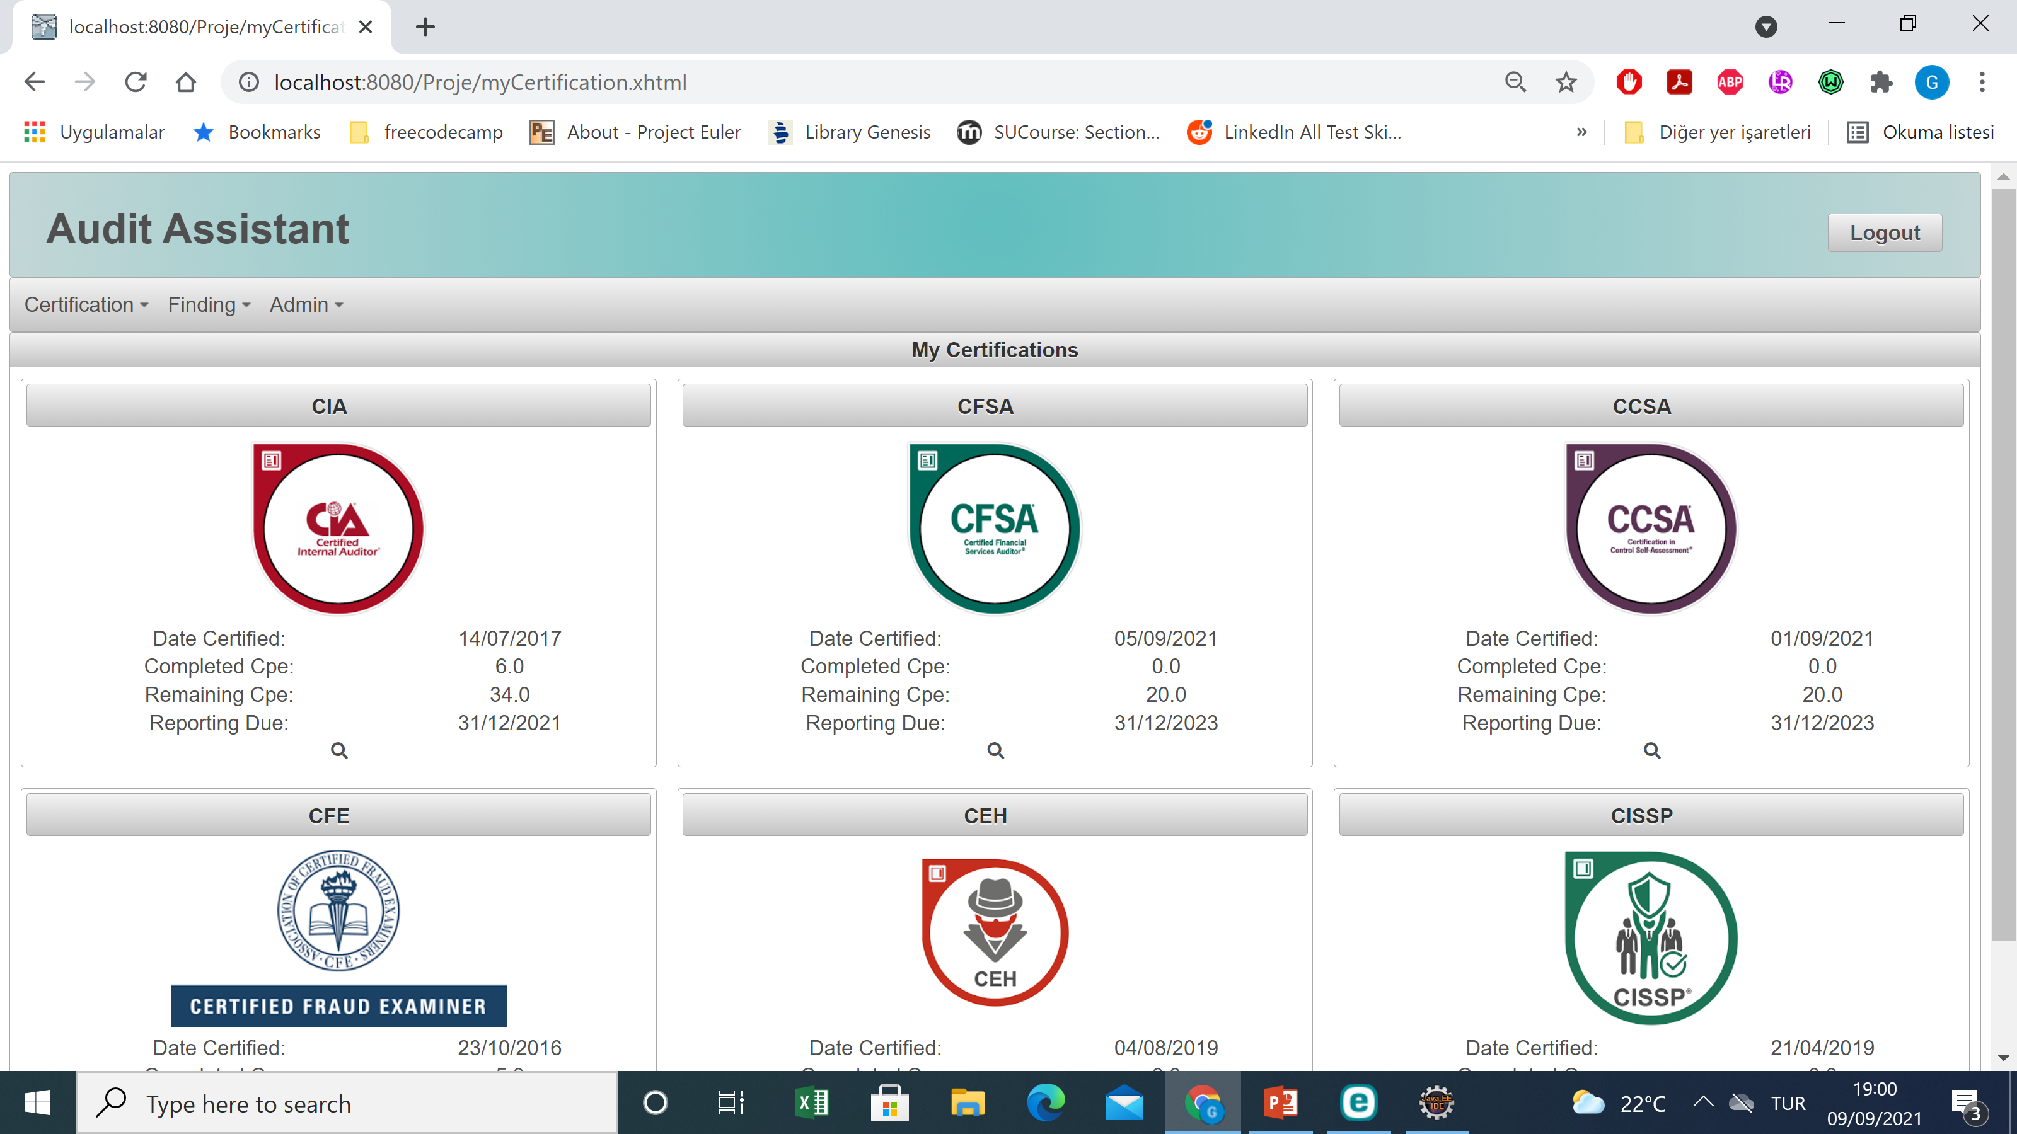

Slide 7
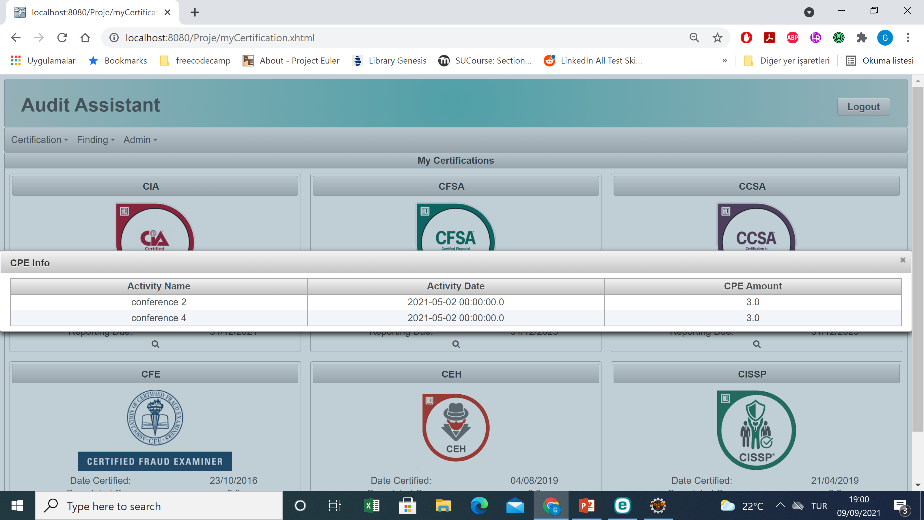

Slide 8
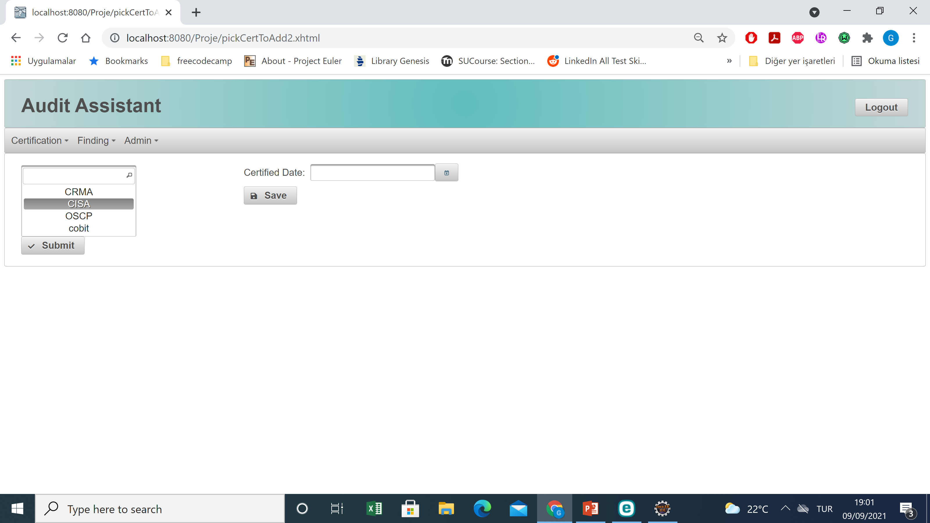

Slide 9
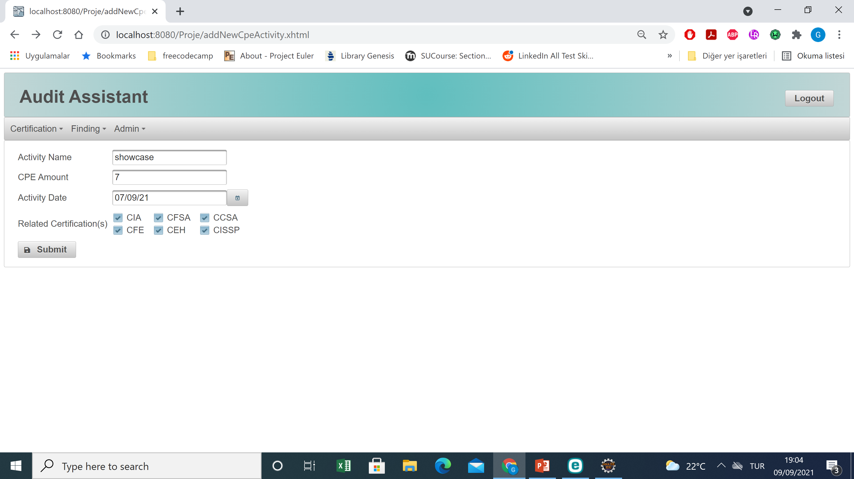

Slide 10


Slide 11
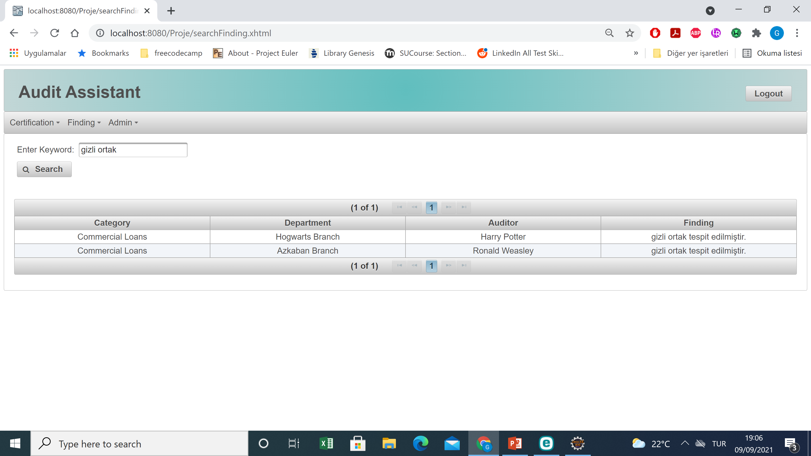

Slide 12
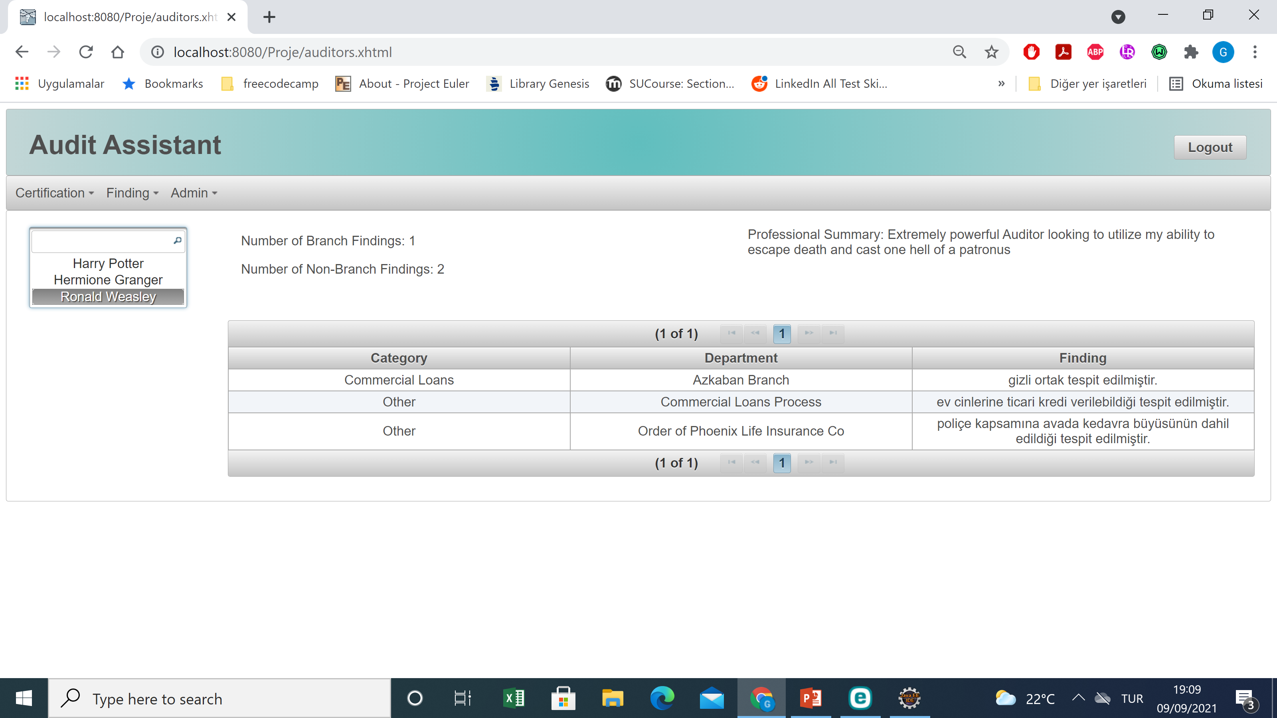

Slide 13
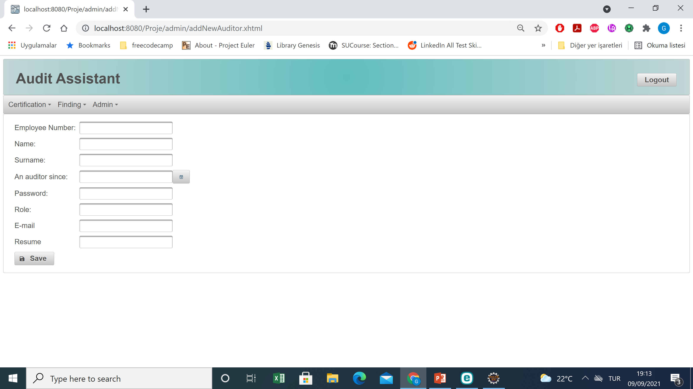

Slide 14
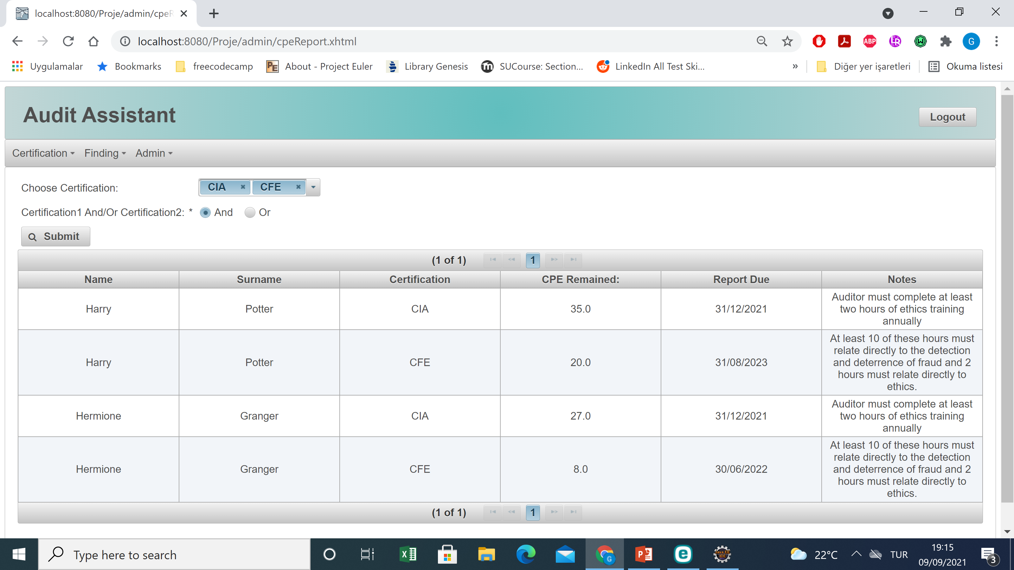

Slide 15
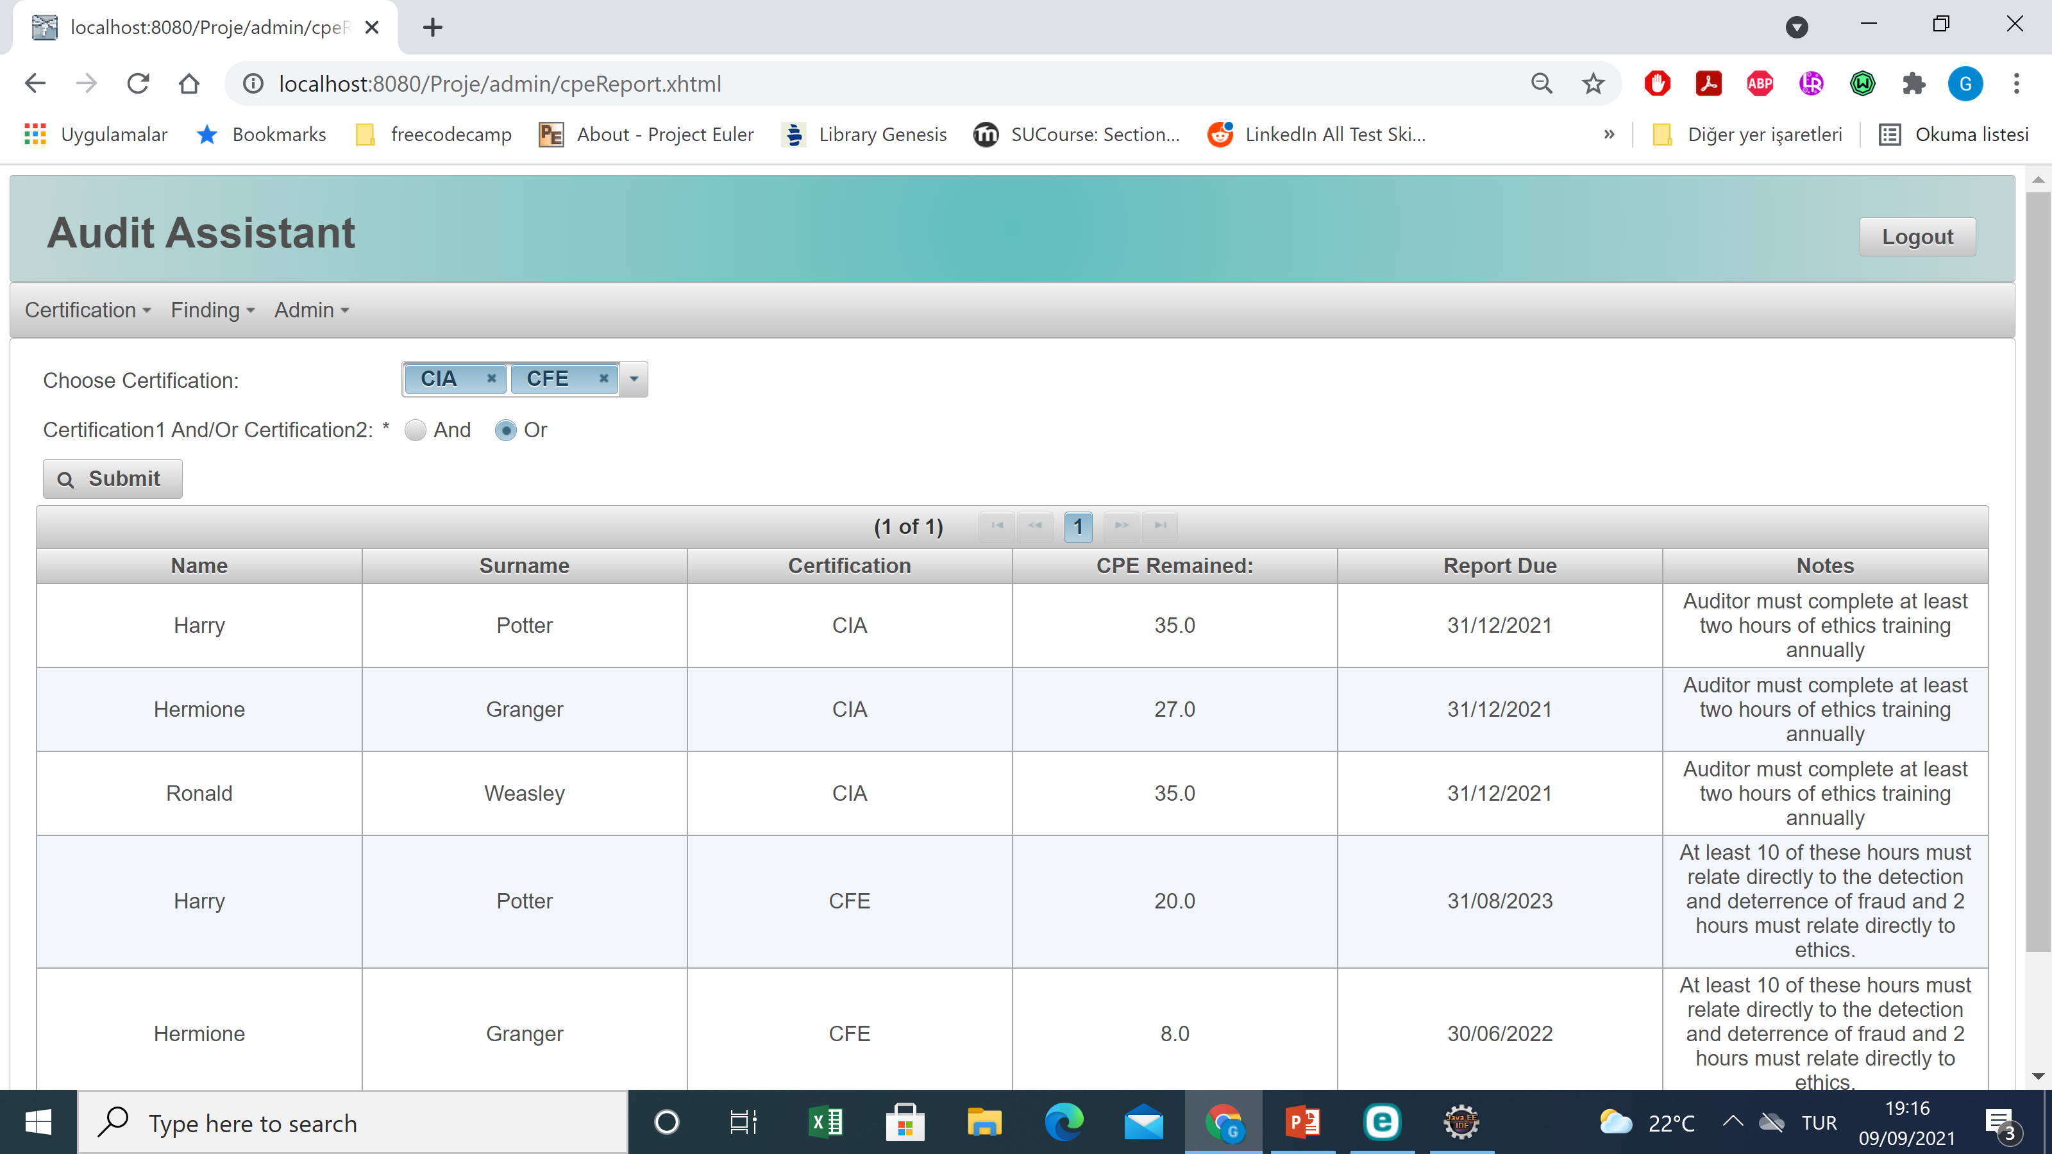

Slide 16
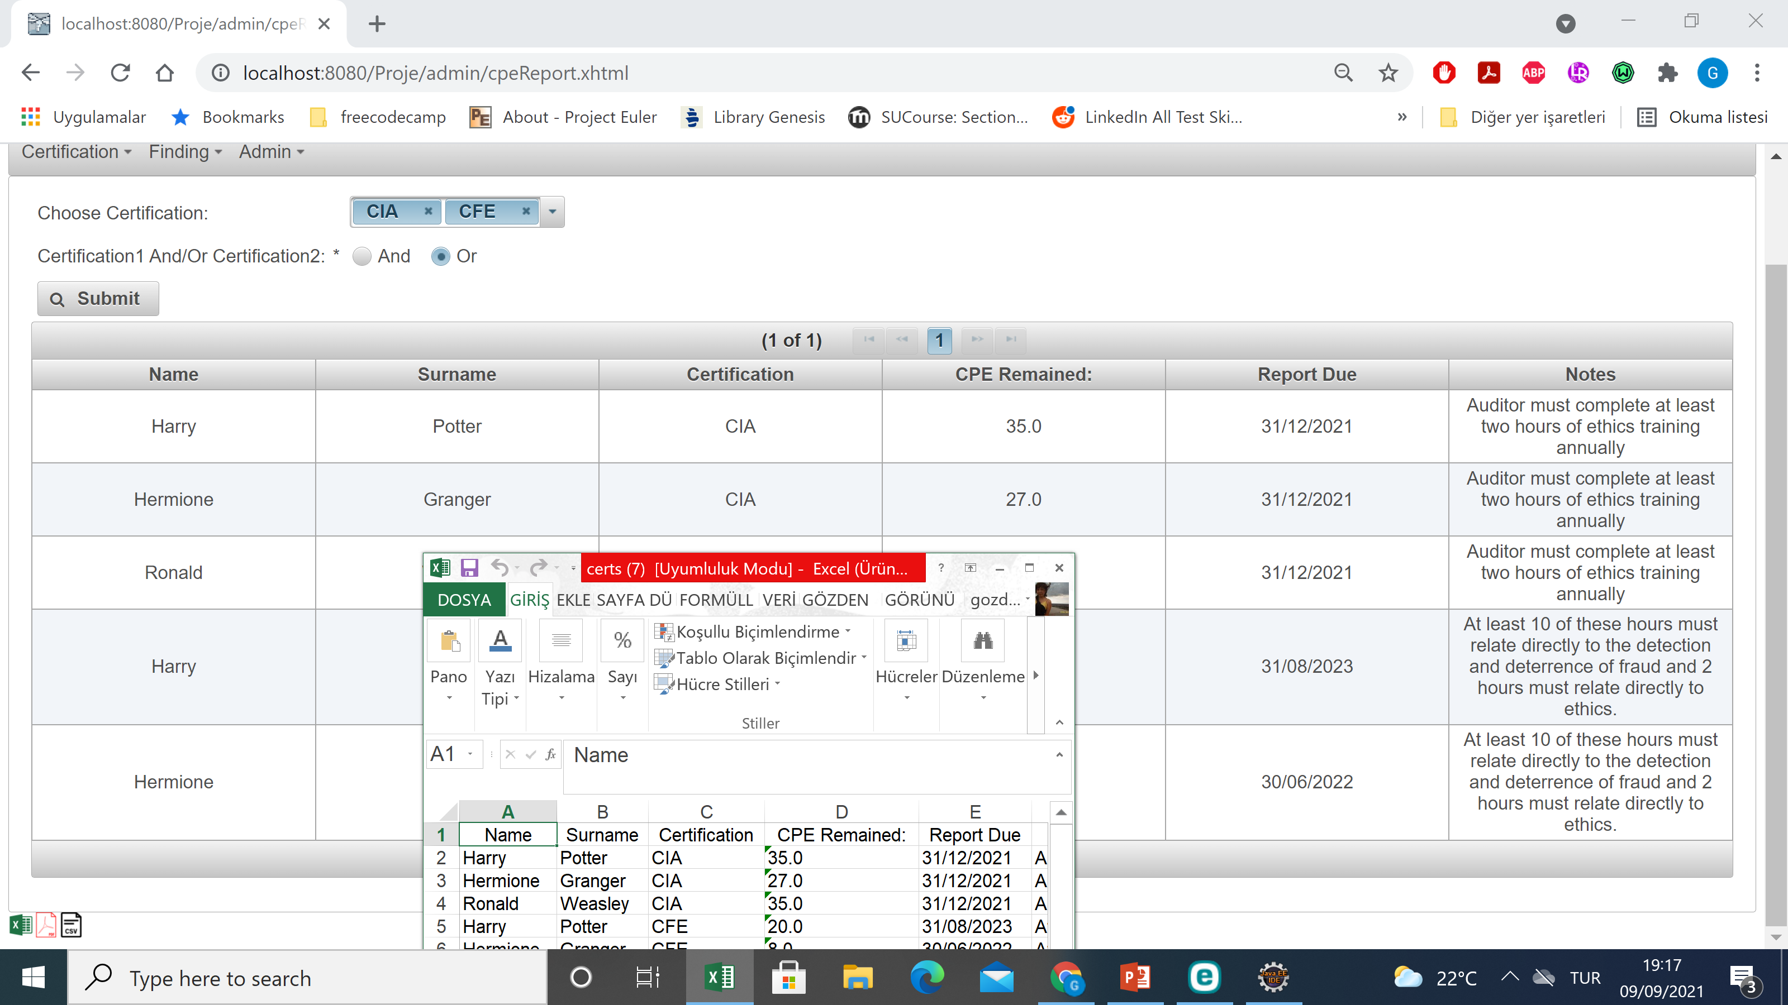

Slide 17
